Slide 1
UBIQUITOUS COMPUTING FOR MOBILE BASED PAYMENTS IN LOCALISED INTELLIGENT TRANSPORTATION SYSTEMS
Authors:
Mutabazi Noble
Ssempala Benjamin
Ntsinga Elijah Mukumbi
Wandera Emmanuel
Presented by -
Group CS23-4
Affiliation: Makerere University
Uganda

Slide 2
Contents of Presentation
Background and motivation
Problem Statement
Project Scope
Literature Review
Our Contribution
Methodology & Research Timeline
Expected outcomes
Research Gaps and Future Works

Slide 3
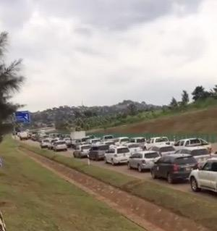
Background and motivation
Traffic systems in many developing cities like Kampala prone to a number of issues
Limited infrastructure
Limited traffic management resources
Solutions such Express toll highways have been put in place.
Suffered a setback of congestion of vehicles as motorists try to make payments
Defeats intended purpose

Slide 4
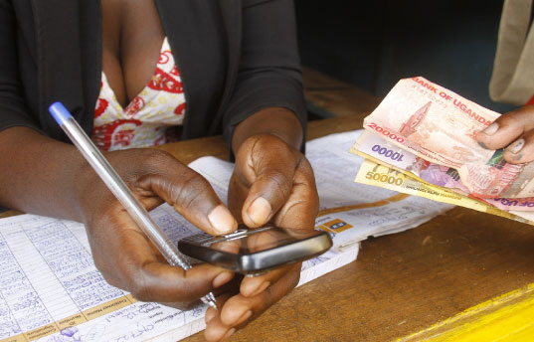
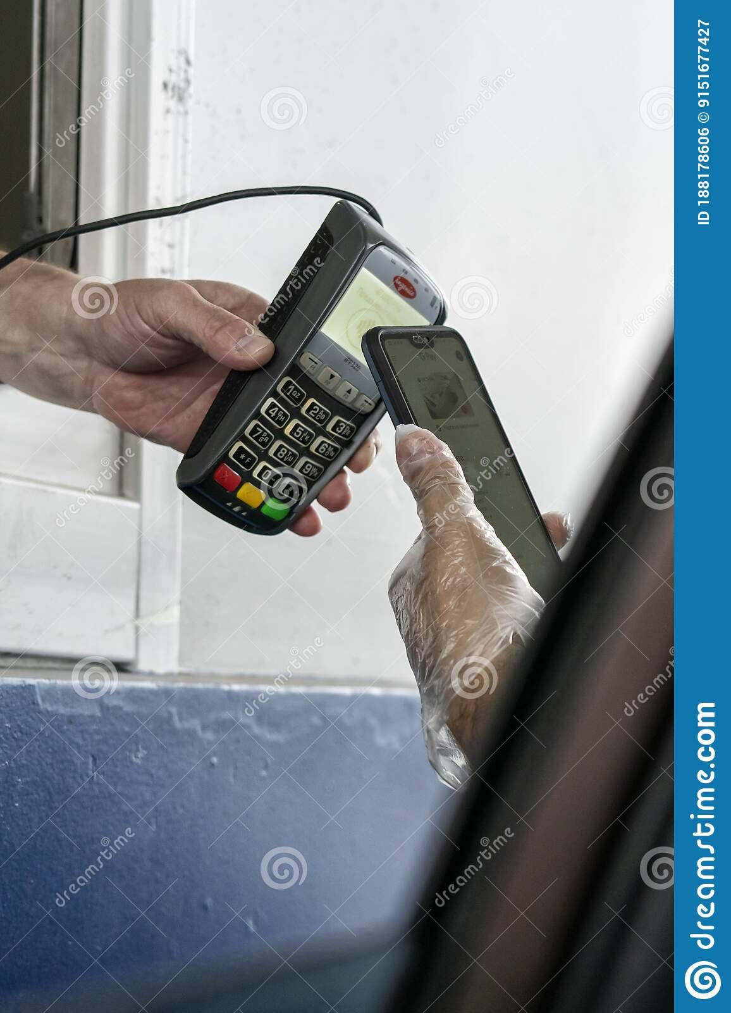
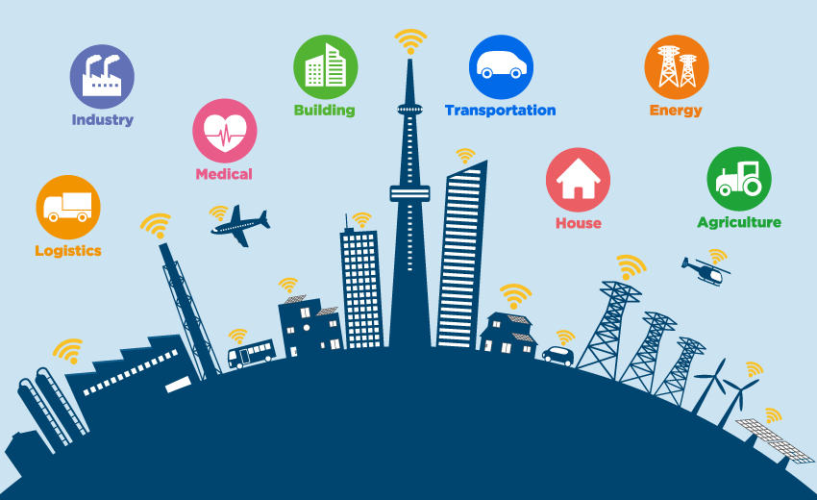
Background and motivation
Research explores how techniques from ubiquitous computing and mobile commerce be used to create a localised solution to simplify these payments
Serves as a demonstration of how intelligent transportation systems can be established in cities like Kampala allowing it to also evolve into a smart city in the long run

Slide 5
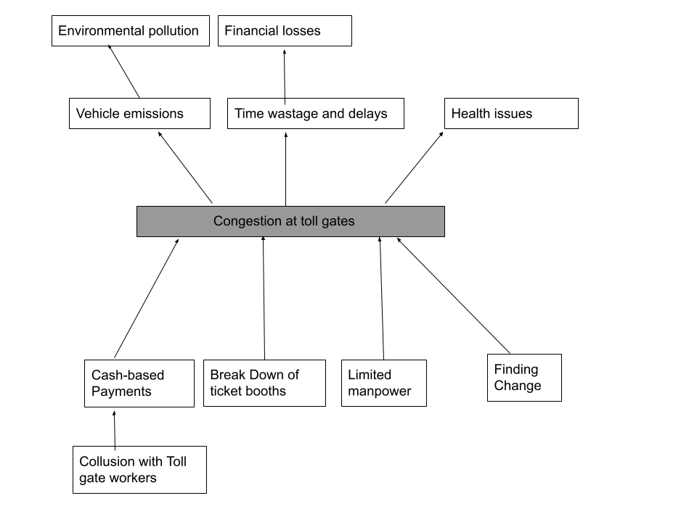
Problem Statement
Toll payment checkpoints at the toll gates often experience
queues and delays as motorists try to pay their toll fees :
limited manpower
finding change
This has long term negative effects:
Economic loss: 6.7% of GDP
Vehicle emissions
Paper wastage for ticket based payments

Slide 6
Objectives of the study
Main Objective
To develop a low-cost secure reliable mobile based system, that leverages ubiquitous computing and mobile commerce techniques, as a component of a larger intelligent transportation system which can be used to simplify and quicken payment of toll fees.
Specific objectives:
To understand the existing payment approach used at Makerere University toll gates.
To design a system prototype for the proposed
To implement the proposed mobile application
To test and validate the proposed system and confirm whether it solves the highlighted problems within the current payment system.

Slide 7
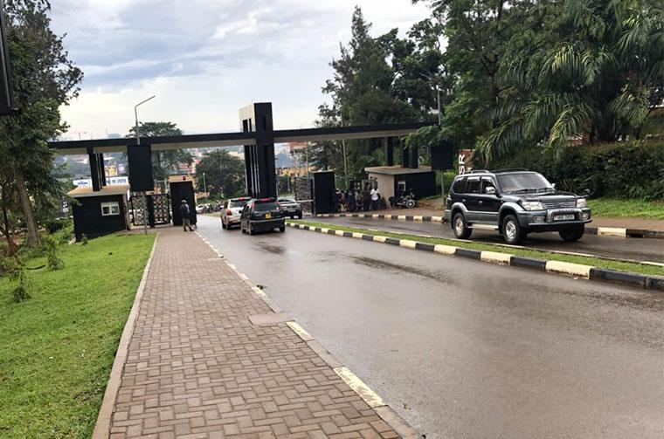
Project Scope
The project currently intends to be implemented within Makerere University, at its four gates

Slide 8
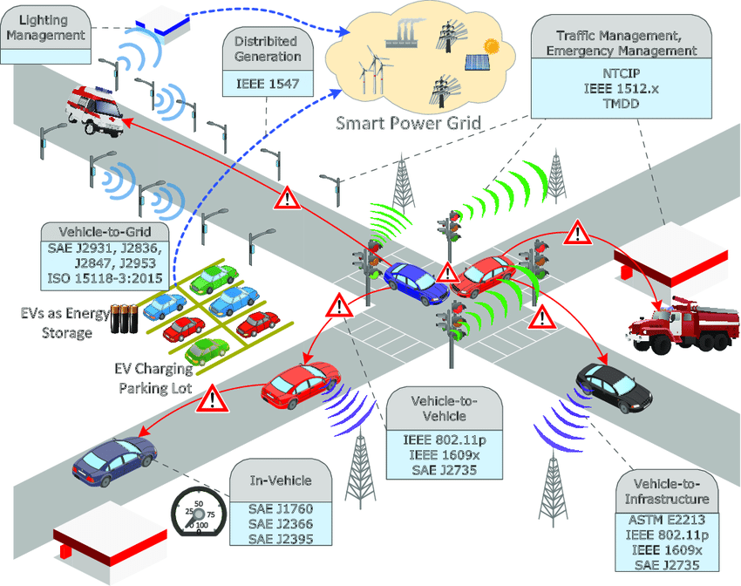
Literature Review : Intelligent Transportation Systems
Intelligent Transportation Systems are technologies that work with applications and are built with the intention of improving safety in the transport sector, and raising productivity for people
leverage information and communication technologies, such as embedded sensors, IOT devices.
Used in efforts like real-time data collection from sensors placed in vehicles or infrastructure,and aggregate this data

Slide 9
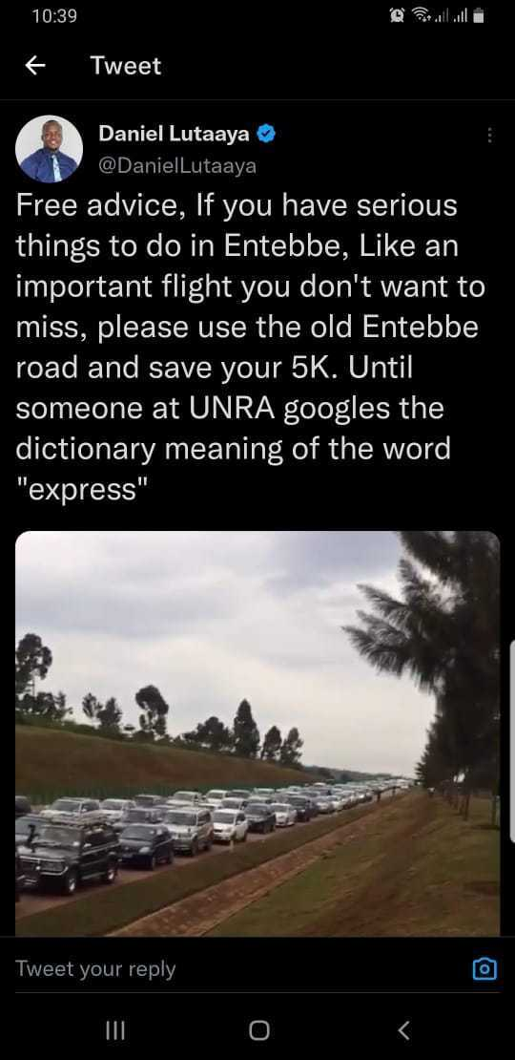
Literature Review : Intelligent Transportation Systems
UNRA Entebbe Express Highway
Uses cash payments mostly causing delays
Cashless involves use of UPESI RFID card, also time consuming
Use of GPS Software and Cell Towers
Danang et al proposed solution that deducts payment basing on motorist proximity to cell tower around toll gate
The researchers acknowledge the need for a deeper feasibility study and the fact as it has some shortcomings
Doesn’t account for some scenarios e.g near the cell tower but not intending to user the gate

Slide 10
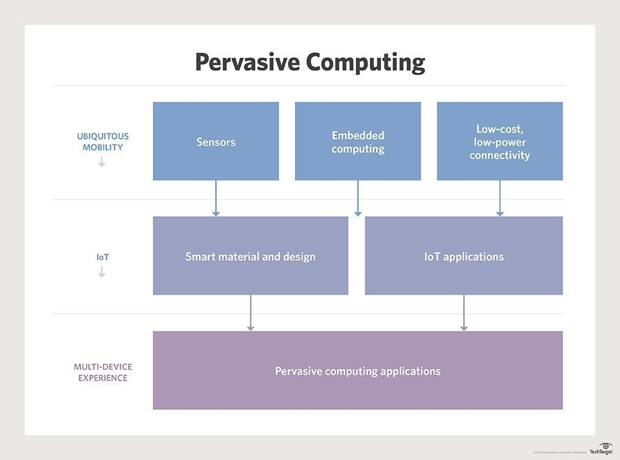
Literature Review : Ubiquitous computing
Ubiquitous computing (pervasive computing) is concerned with countless small, wirelessly intercommunicating microprocessors, embedded into objects.
Applied in similar concepts, such as “the Internet of things”
Sensors can capture information on environment and process or share over a network

Slide 11
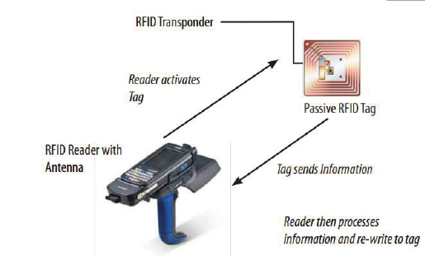
Literature Review : Ubiquitous computing
Use of RFID technology
consists of transponder to store information and reader to capture it
Sabbir Ahmed et al. proposed toll payment with RFID tags.
Inapplicable in Uganda, as it would require digitisation of all vehicle license plates
Long range RFID scanners also costly thus need for a cheaper alternative

Slide 12
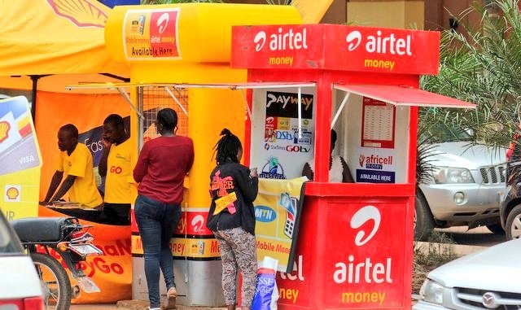
Literature Review : Mobile Commerce
E-Commerce concerned with buying and selling goods online. Subset is mobile commerce - similar but specific to mobile devices
Comprises mobile shopping, banking and payment
Research focuses on payment aspect.
Commonest implementation in Uganda is use of mobile money platforms
In Uganda, 43% use M-money compared to 11% with bank accounts
Offers security, convenience, and speed

Slide 13
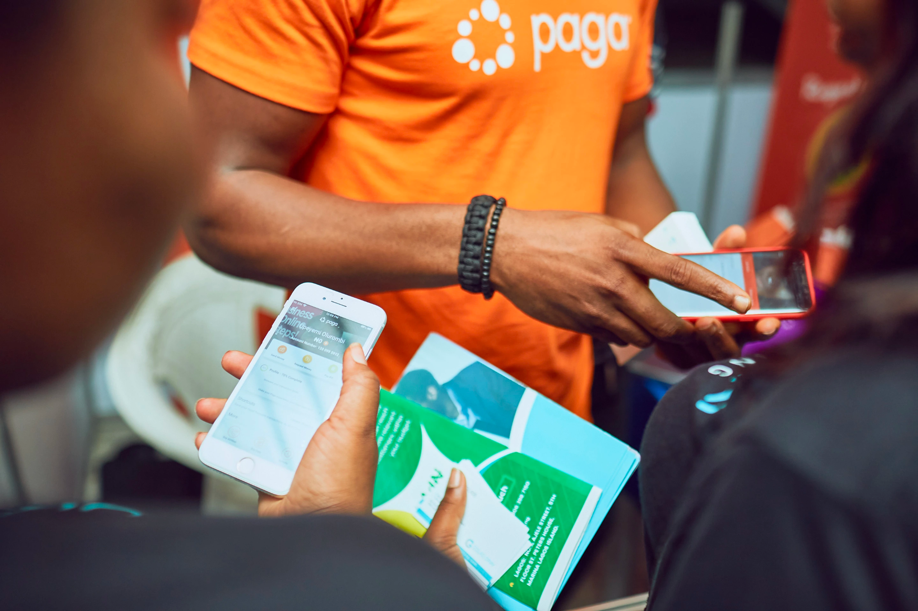
Literature Review : Mobile Commerce
UNRA Entebbe Express Highway
UPESI cards use M-money
Inefficient as they require manual scan
Use of NFC technology
Technology that allows two devices to communicate wirelessly when they are close together.
Rugnesh et al. proposed toll payment with NFC enabled mobile app
Inapplicable in Uganda, as it’s not supported by Ugandan payment systems

Slide 14
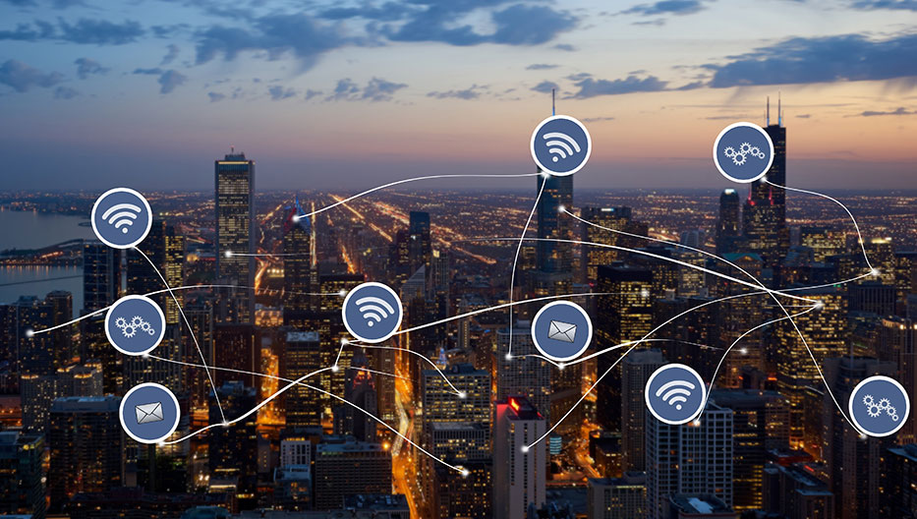
Literature Review : Smart Cities
Form of urbanization that leverages technology from a variety of domains e.g IOT, cloud computing, mobile
Used to improve infrastructure and service delivery, while lowering costs of resource consumption
Canada Express Toll Route
Motorists create accounts on web application, and receive tag placed inside vehicle
Scanned by camera and deductions made
Costly to implement

Slide 15

Project Significance (Our contribution)
Quickening the toll payment process, allowing for prepayment using local preferred payment platforms such as MTN mobile money, increasing the system’s accessibility to individuals in Uganda.
Use of embedded QR technology as an alternative to RFID tags and scanners which are costly.
Step in the right direction towards achieving SDG13

Slide 16
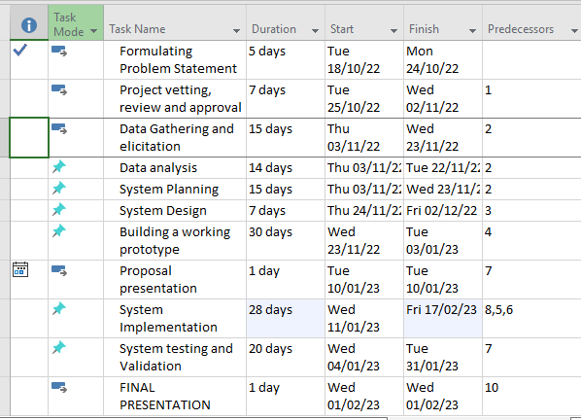
Methodology

Slide 17
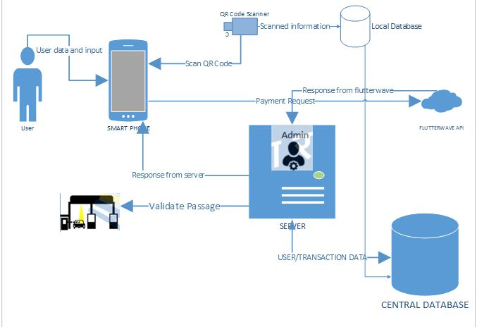
SYSTEM ARCHITECTURE

Slide 18
Expected Outcomes
• Informative results on testing and evaluating the current payment system used at toll gates in comparison to the new proposed system
• A well developed and operational cross-platform mobile application to enable payment of toll fees as well as verification of the payments. This application will be available for both iOS and Android mobile platforms
• A functional embedded QR Code scanner that’s able to capture QR code values and verify payments that have been made.

Slide 19
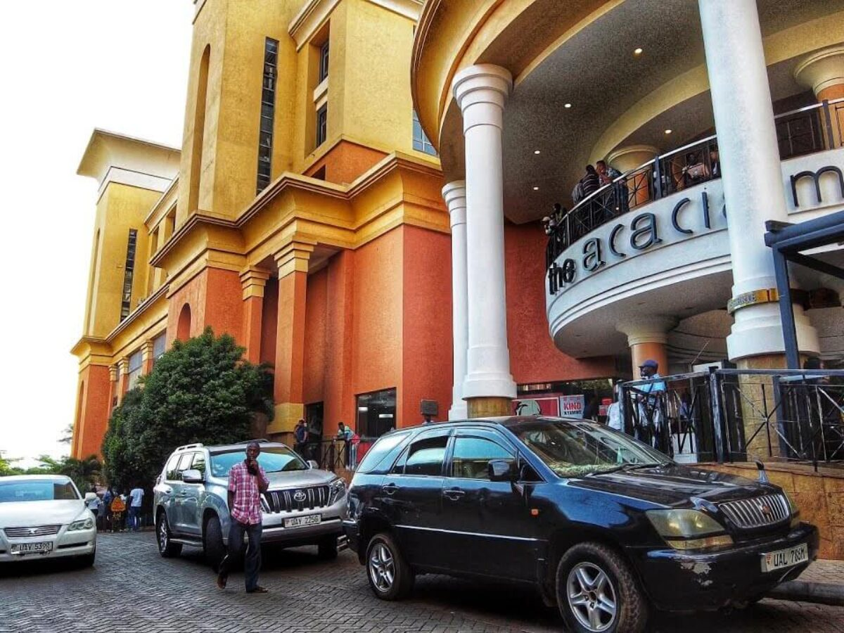
Research Gaps and Future Works
Implementation is limited to Makerere University
The project currently only accounts for smartphone users
In future works:
System can be utilised in other public places such as malls, hospitals
The system can also be improved to account for non-smartphone users

